Slide 1
Job Performance, Satisfaction, and Attrition Analysis
MS Azure: MI - 462
By: Jordan Lewis

Slide 2
Introduction
I am interested in focusing on data analytics and internal efforts and strategies within companies
If you can’t keep your employees happy, will your own customers be happy?
Internal Market Research
Was able to find dataset that would let me practice that
While training on MS Azure, I tried many different platforms
Landed on Data Explorer because it was user friendly

Slide 3
More about the Data Set
Found on Kaggle
Based on IRL company and their data
Dataset includes information pertaining to attrition(how many employees leave a company), job satisfaction and other important employee data that pertain to their job
Contains categorical and numerical data

Slide 4
Data Set In Depth
Age, Attrition, Business Travel, DailyRate,Department, distance from home, Education, Education field, EmployeeCount, Employee number, Environment Satisfaction, Gender, Hourly Rate, Job Involvement, Job Level, Job Role, Job Satisfaction, Marital Status, Monthly Income, Monthly Rate, Number of Companies Worked, Over 18, Overtime, Percent Salary Hike, Performance Rating, Relationship Satisfaction, Standard Hours, Stock Option Level, Total Working Years, Training Times last year, Work life balance, Years at company, Years in current role, Years since last promotion, years with current manager
No Nulls !
Over 1400 entries !

Slide 5
Problems with MS Azure
-Original Dataset was too big for MS Azure and data factory
-Started on Data factory and tried to use the notebook function, did not work because my file was too big
-When I used my newest dataset, datasynapse and data factory did not like my data either
-While I was doing all of everything my subscription ended and I wasn't able to do everything I wanted to and I was unable to make a new account

Slide 6
What I went with
Data Explorer
ETL process was super easy
Interface was user friendly
Making visuals was very easy
Only barrier was learning KQL
Had to translate from SQL TO KQL

Slide 7
Goals and Questions for this Analysis
Attrition
Satisfaction and Performance
Improvement
Investigate why people are leaving. What factors are making them leave?
How do our employees feel about working here? Do they feel accomplished?
In what ways can we improve attrition and increase retention? How can we maintain satisfaction and job performance rankings?

Slide 8
Attrition… What is it and why is it important?
You might have heard of Retention
How employers keep their employees and how many stay
Attrition is the opposite
How many employees leave a company
Why do employees leave? Is there any factors that could contribute to them leaving? How can we improve it?

Slide 9
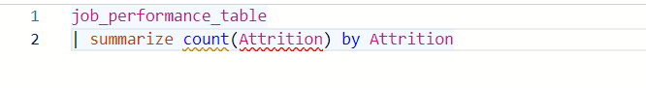
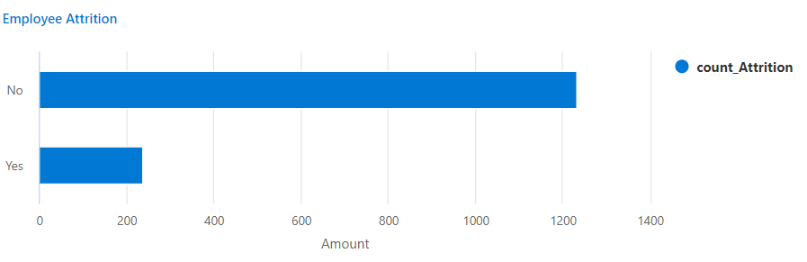
Attrition Overview

Slide 10
How is Attrition looking for this company?
Majority of the company is staying!
Retention is high and attrition is low
About 84% of employees will be staying
What about the other 16%?
This is moderately high number, why are people leaving?

Slide 11
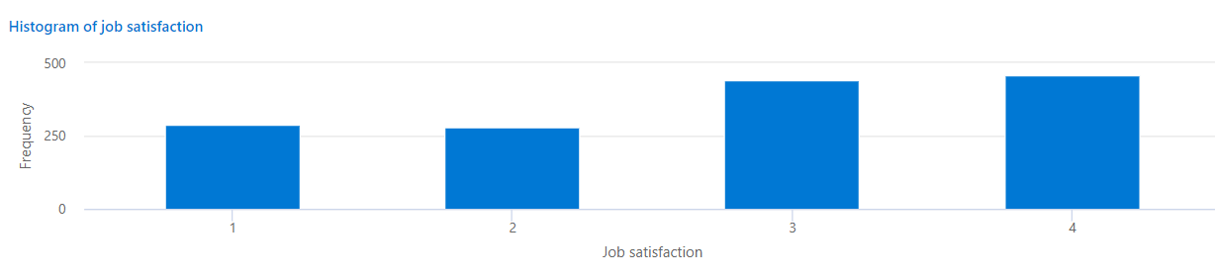
What does our overall Job Satisfaction look like?
Using KQL, I created a histogram of the distribution of what employees put for their satisfaction
1 being the not satisfied at all and 4 being extremely satisfied

Slide 12
What does the histogram show?
Our distribution is slightly skewed left and almost flat
Majority of the responses are positive being a 4 and second being 3
This shows most employees are satisfied with their job and work

Slide 13
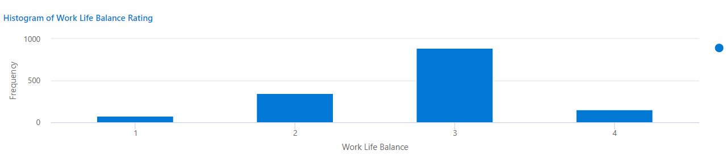
What about work life balance?

Slide 14

What does this histogram show?
Our distribution is more normal looking (bell curve)
Most of our responses are concentrated in the middle
Most employees have an average work life balance
There is still a good portion who rated a 2
Might be worthy to be investigated later

Slide 15
Gender Analysis
Making sure equity and inclusion is kept to a high standard is an important part of retention and job satisfaction in a company
If there is a problem with how different genders are treated, that could impact the data and job satisfaction and attrition.

Slide 16
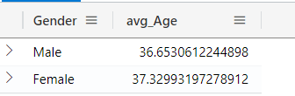
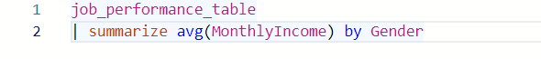
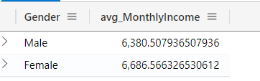
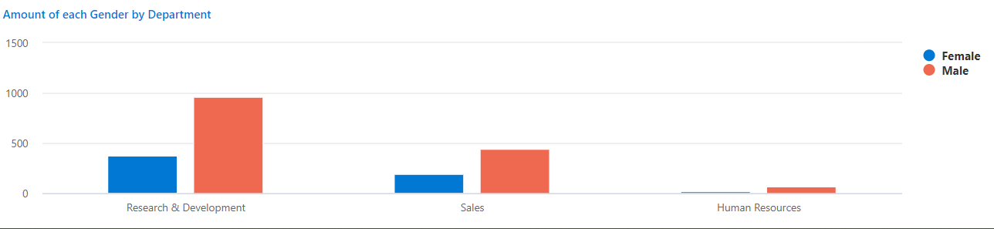
Gender Analysis Basics

Slide 17
Gender Analysis
The average age for both genders is very close being 36 and 37
Their monthly income is also very close
This ensures that there is no income gap
There is a more males than females in each department

Slide 18
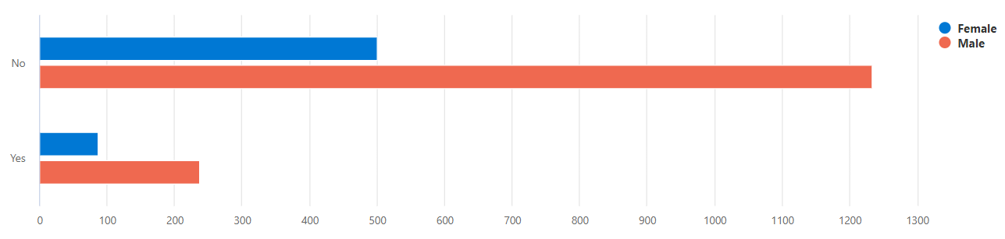
Gender Analysis Cont.

Slide 19
Gender and Attrition
The previous bar chart displayed the amount of male and females who said they were staying and who were leaving the company
Because there is more men in the set, the males are the majority in each response
The biggest insight to this chart is that for the “No” response the amount of males and females are very close
This shows that there is no issues with Gender at the company that would cause someone to leave

Slide 20
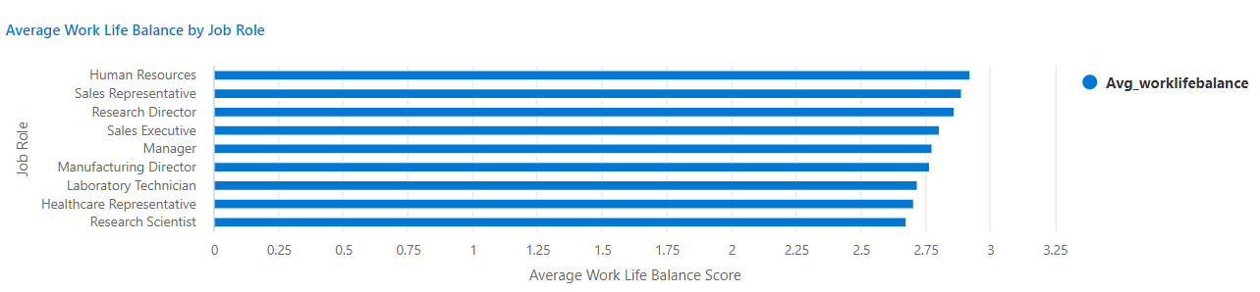
Does your Job Role impact your work life balance?
Let’s look at how different Job Roles rate their work life balance

Slide 21
What is the chart telling us?
All job roles have very similar average work life balance ratings
Human Resources have the highest average score and Research Scientist have the lowest average score
Our their jobs too hard?

Slide 22
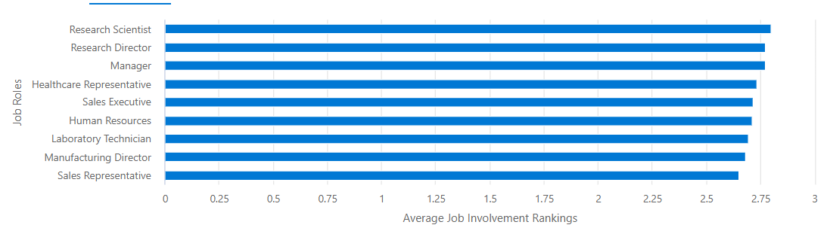
What does the average Job involvement ranking for each Job role look like?

Slide 23
What does this mean? Is there any patterns?
Research Scientist report to have the highest Job Involvement average
They are reporting that their job is pretty demanding
Sales Representatives report to have the lowest job involvement
The two bar graphs seems to be almost inverse of each other with Research Scientist having the highest job involvement but the lowest work life balance
Are we giving employees too much work?

Slide 24
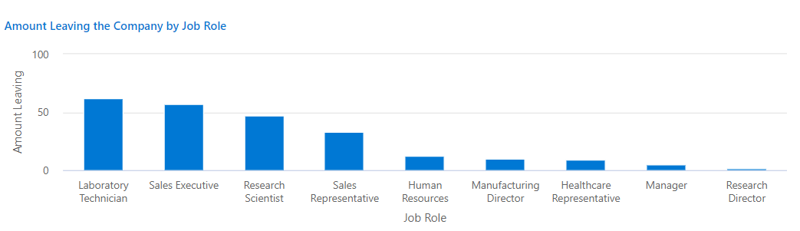
Does the Attrition Numbers Match?

Slide 25
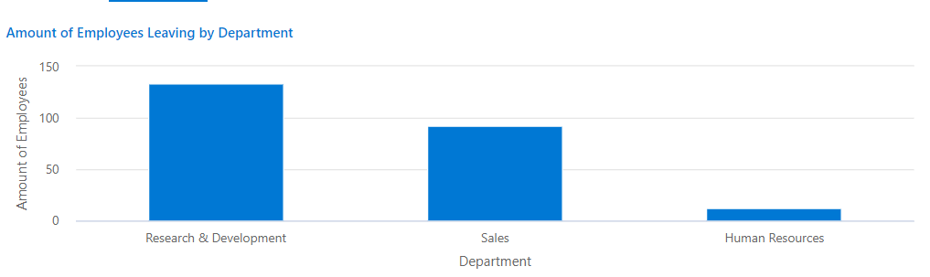
Attrition Numbers by Department
18%
34%
Jupiter is the biggest one
Mercury is the smallest planet
Mars is a cold place

Slide 26
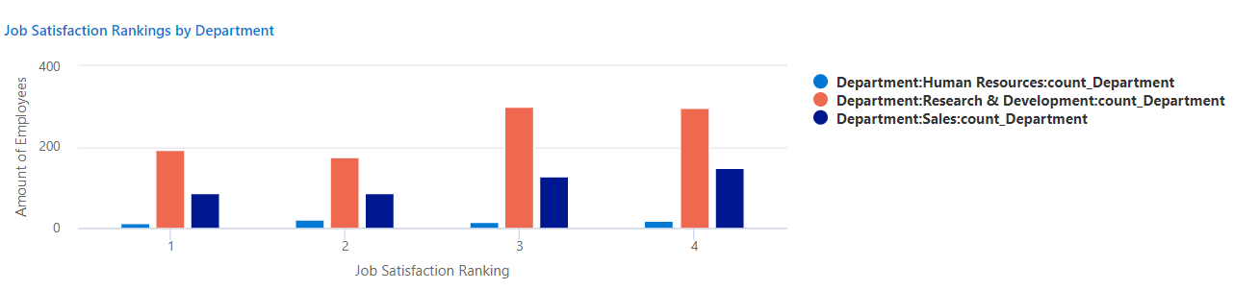
Job Satisfaction Rankings by Department

Slide 27
What did we learn?
Research Scientist was in the top 3 for amount leaving the company
The Research and Development have the largest amount of people leaving the company
Job Satisfaction is still pretty equal through each department
There is no direct correlation but the company needs to look closer into the roles that are in Research and Development

Slide 28
What other factors might contribute to job satisfaction and performance?
Income
Promotions
Years at the Company
Salary Increases

Slide 29

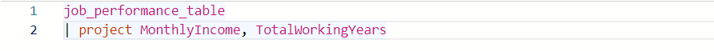
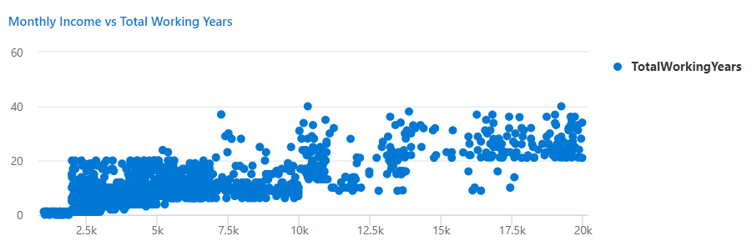
Does your past work experience impact your Monthly Income?

Slide 30
Insights
There seems to be a slight positive correlation between monthly income total working years
This means the company is properly paying people by their experience level
This is positive for retention

Slide 31
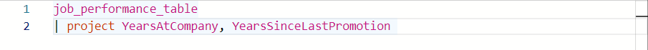
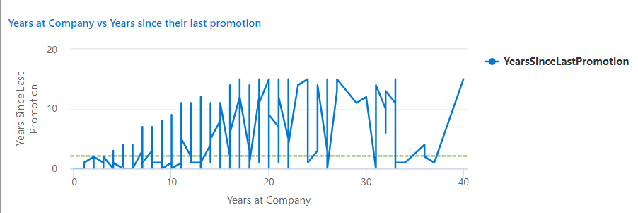
Does the amount of time with the company impact the time you get a promotion?

Slide 32
Insights
By looking at the graph, there is little to no correlation between the amount of years at the company and years since last promotion
Trends seem to be very irregular and not consistent
In companies, most corporations try to reward loyalty with a promotion
Looking at the graph, there are people that have worked with the company for decades but haven’t received a promotion in decades
The line represents the average amount of years it takes to receive a promotion
This shows the company might not prioritize or appreciate loyalty

Slide 33
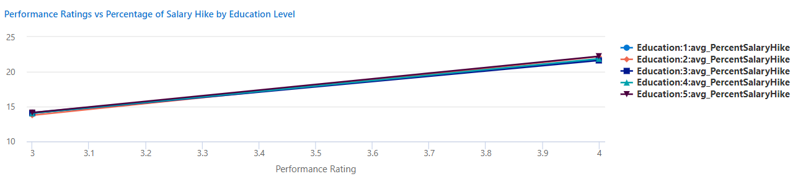
Does your education level impact your salary hike and do you get a salary hike when your performance rating is high?

Slide 34
Insights
All Education Levels have almost the same positive correlation
The highest education level 5 being the highest by not that much
The visual shows that with higher performance ratings is a bigger salary hike which is positive for employees
But with different education levels, the difference between them is not different
Employees might believe that their education efforts might not matter or are not in consideration for their job

Slide 35
Overall Insights and Conclusions on Analysis
The company is doing well with retention overall
Job Satisfaction is good and work life balance is average
Maintain equity and inclusive culture
To help with attrition and job performance, sit down with the employees in the Research and Development department to see what they need and if they need any support with their work and workload
Start to reward loyalty with promotions and salary hikes
Also start rewarding higher education

Slide 36
My thoughts and journey with MS Azure
This was fun!
I enjoyed learning about MS Azure and new data analytics tools
My dataset was interesting and fun to work with
At first, MS Azure was difficult to learn and use with all the different tools and platforms
Once I stook with a platform (Data Explorer), it wasn’t so bad
Going from SQL to KQL was a bit challenging but I am glad to know some basics now
I wish I was able to get the actual correlation coefficient for some of my analysis but I was unable to
I was also not completely able to finish my whole analysis because my subscription randomly ended on me and I was unable to use another account

Slide 37
THANK YOU !

Slide 38


